Slide 1
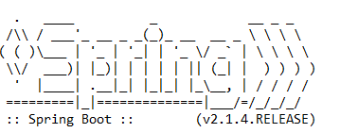
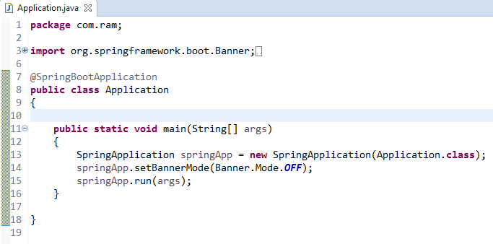
How to disable spring logo banner in spring boot?
By default, all spring boot applications will show up below spring logo banner in all spring boot applications.

